Slide 1




COAPPS
DATA SCIENCE
ENERGY DEMAND PREDICTION
SMART GRID ANALYSIS
AGNI COLLEGE OF TECHNOLOGY

Slide 2


CONTENT
01
02
03
04
About Us
Abstract
introduction & summary
Existing works & literature survey
05
06
07
08
Dataset Collection & overview
Methodology
Web development
Visualization & Results

Slide 3



ABOUT US
Team members
Saran raj B
Sri Rakshaga SR
Abdul althaf AL
Forecasting And Prediction of Energy Demand - Smart Grid Analysis

Slide 4




INTRODUCTION
In this era of rapid technological advancement and growing environmental concerns, the ability to accurately predict energy demand has become crucial for promoting sustainable energy consumption and efficient resource management.
Our project leverages the power of Jupiter Notebook and a suite of advanced analytical models to tackle this challenge. Utilizing tools like Pandas, Numpy, Matplotlib, Seaborn, Missingno, and Sklearn.metrics, we have developed a comprehensive approach to analyze and forecast energy patterns.
This presentation will guide you through our journey from data acquisition to the development of a predictive model using Support Vector Machine and Random Forest Regression. We will also discuss the creation of a web application using Streamlit, designed to make our predictive model accessible and user-friendly.

Slide 5



Summary
By integrating data’s within the energy infrastructure, our team has developed predictive models that significantly enhance the efficiency and reliability of energy distribution.
Using advanced analytics to forecast energy needs with unprecedented accuracy.
underscoring the broader implications of our work for a sustainable energy future. It invites readers to explore the detailed methodology, development process, and collective expertise that have brought this vision to fruition.
As we look ahead, the project’s success opens avenues for further advancements, including the integration with renewable energy sources, real-time data analytics, and the exploration of more complex machine learning models. These efforts will not only refine our predictive capabilities .

Slide 6



KEY FINDINGS
Existing works
The field of energy demand forecasting has seen a variety of approaches, with significant contributions from both academia and industry.
Prior works have focused on the application of statistical methods, machine learning algorithms, and simulation models to predict energy consumption with varying degrees of success.
Literature survey
Predictive Analytics for Grid Optimization: Predictive analytics has emerged as a crucial tool for optimizing grid operations. Techniques such as optimization algorithms and demand response strategies are being explored to balance supply and demand effectively.
Machine Learning for Energy Demand Forecasting: Machine learning, especially regression-based and time series models, has been widely adopted for forecasting purposes.

Slide 7


DATASET OVERVIEW
The foundation of data-driven project lies in the quality and robustness of the datasets in Kaggle are used. we meticulously selected and processed datasets to ensure the highest standards of data integrity , accuracy and relevance. Here’s an overview of the dataset collection process:
BUILDING ENERGY COSUMPTION
WEATHER DATA
WEATHER COST
This dataset can overview about the hourly hours (HH), hourly precipitation (RH),global variation(Q),Wind speed(FF),Dewpoint temp(TD),Relative humidity(U) & Duration of fx(DR)
This dataset can overview about HH , RH , Q, FF , TD , U, DR and also Hourly cost price (P)
This dataset overview about the energy consumption of building with time, month, temperature (TEMP),and energy demands

Slide 8
METHODOLOGY
1
EXPLORATORY DATA ANALYSIS
5
MODEL EVALUATION & SELECTION
2
DATA PREPROCCESSING
6
GRID SEARCH
3
FEATURE SELECTION
7
VISUALIZATIONS OF ACCURACY
4
MODEL TRAINING & HYPERPARAMETER TUNING
7
BUDJET ALLOCATION

Slide 9

EXPLORATORY DATA ANALYSIS (EDA)
Trend Analysis:
Time-series plots were generated to visualize energy generation and consumption trends over time, allowing for the identification of patterns or anomalies that could influence the forecasting models.
Correlation Analysis:
Correlation matrices and pair plots were created to identify relationships between variables. This helped in understanding how different features might influence energy demand and in selecting relevant features for the predictive models.
Feature Distribution:
Distribution plots were used to understand the spread and skewness of the data. This is crucial for identifying the normality of the features and determining if any transformations are needed to improve model performance.
Time-based Features:
Year, month, day, and hour were extracted from timestamps to capture seasonal and diurnal patterns in energy consumption, which are essential for accurate forecasting.

Slide 10


DATA PREPROCCESSING
Data Cleaning:
Outliers were identified and removed to prevent them from skewing the results. Missing values were handled using forward-fill imputation to maintain data continuity and integrity.
Feature Engineering:
New features were created from raw data to provide more insights into the energy consumption patterns. This included time-related features like the day of the week, month, and hour to capture seasonal and diurnal patterns.
Data Transformation:
Numerical features were scaled to ensure that no single feature would dominate the model due to its scale.
Categorical variables were encoded to convert them into a numerical format that can be used by machine learning algorithms.
Data Splitting:
The data was split into training and testing sets to evaluate the performance of the models on unseen data.

Slide 11
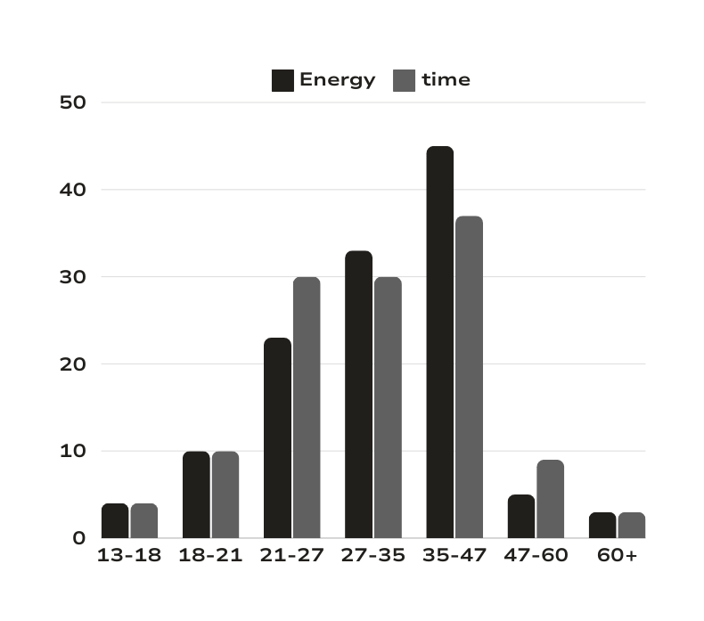
FEATURE SELECTION
1.Domain Knowledge:
Utilizing domain expertise to identify features that are likely to influence energy demand, such as temperature, time of day, and historical usage patterns.
2.Feature Importance Scores:
Employing algorithms that provide feature importance scores to determine which features contribute most to the model’s predictive power.
3, Ensemble Methods:
Using ensemble methods like random forests, which inherently perform feature selection by averaging over many decision trees that consider different subsets of features.
4.Recursive Feature Elimination:
Applying recursive feature elimination techniques to iteratively construct models and remove the least important feature at each step.

Slide 12
MODELS SELECTION & HYPERPARAMETER TUNING
When training models using Support Vector Machine (SVM) and Random Forest Regression, the process involves several steps to ensure that the models are well-tuned and capable of making accurate predictions. Here’s an overview , we have approached model training and hyperparameter tuning for these algorithms:
Support Vector Machine (SVM):
Model Training:
SVMs were trained using the selected features from the preprocessing step.
The kernel type (linear, polynomial, radial basis function, etc.) was chosen based on the nature of the data.
Hyperparameter Tuning:
C (Regularization Parameter): Controls the trade-off between achieving a low training error and a low testing error that is, the complexity of the decision boundary.
Gamma: Determines the influence of a single training example; low values imply ‘far’ and high values imply ‘close’.
Kernel Coefficient: For non-linear hyperplanes, this defines the complexity of the decision boundary.

Slide 13
Random Forest Regression:
Model Training:
Random forests were trained using an ensemble of decision trees to predict continuous outcomes (energy demand).
The number of trees and the depth of each tree were key parameters.
Hyperparameter Tuning:
standard scalar : standardise the data to a range in mean is equal to 0 and standard deviation is 1.
minmax scalar : normalize the data and brings value b/w O and 1.
robust scalar : standardize the data but it is more robust to outlines , because it only scales data according to inequartile range IQR

Slide 14
Model Evaluation & Final Model Selection
Model Evaluation:
Models are evaluated using various performance metrics, including accuracy, precision, recall, and x1 score, on both training and test datasets.
The confusion matrix is visualized to understand the model's predictive behavior and identify areas for improvement.
Final Model Selection:
The RandomForestClassifier - STANDARD SCALAR is selected as the final model for ENERGY predection, based on its superior performance across multiple metrics and robustness to overfitting.
Justification:
RandomForestClassifier outperforms other models in terms of accuracy, precision, recall, and x1 score, demonstrating its efficacy in accurately classifying phishing websites and minimizing false positives.
Random forests or random decision forests are an ensemble learning technique for classification and different assignments that works by developing a huge number of decision trees at training time and yielding the class that is the method of the classes.

Slide 15
Grid search
Grid search is a systematic method used to optimize hyperparameters for machine learning models, and it was a key technique in your energy prediction project. Here’s an overview of how grid search was utilized:
Hyperparameter Definition:
Hyperparameters are parameters whose values are set before the learning process begins. For the project, hyperparameters such as the learning rate and regularization strength were crucial.
Grid Search Process:
A grid of potential hyperparameter values was defined. For instance, learning rates might range from 0.001 to 0.1, while regularization strengths could vary from 0.01 to 1.0.
The model was trained using each combination of hyperparameters within this grid.
Performance Evaluation:
The model’s performance for each hyperparameter combination was evaluated using metrics like accuracy or mean squared error, often employing cross-validation techniques for a more robust assessment.
Optimal Hyperparameters Selection:
The combination of hyperparameters that resulted in the best performance was selected as the optimal set for the model.
In that we took heperparameters as (EPSILON - 0.03, C-30 , GAMMA-5 ) for our energy prediction

Slide 16
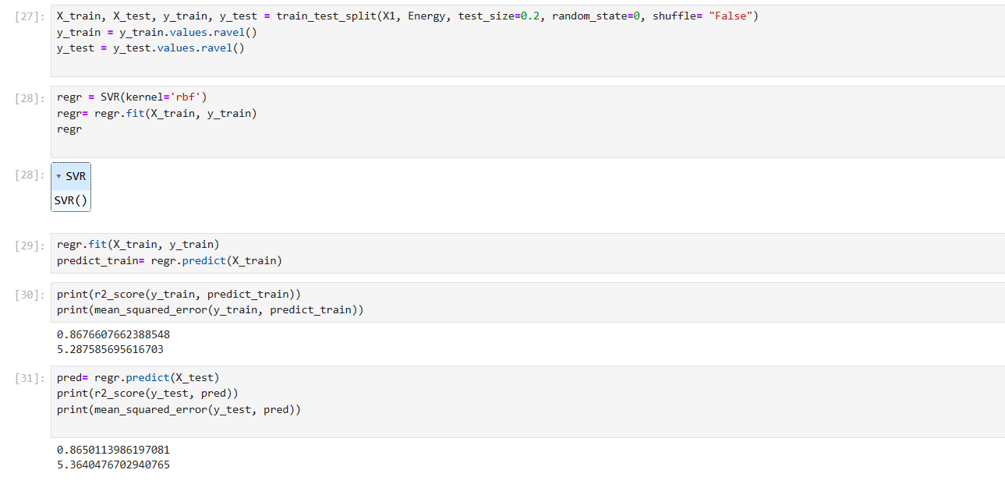
visualizations of accuracy

Slide 17
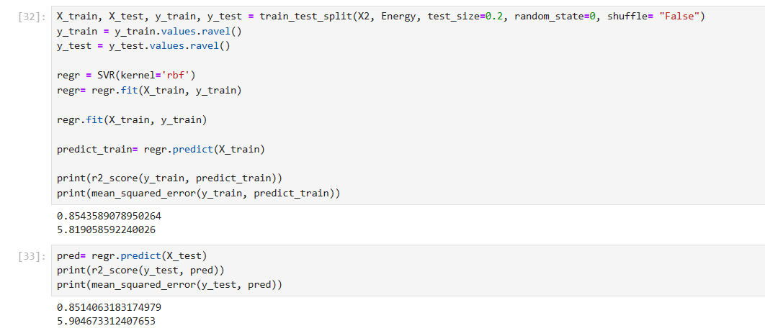
Comparing with different kernals

Slide 18
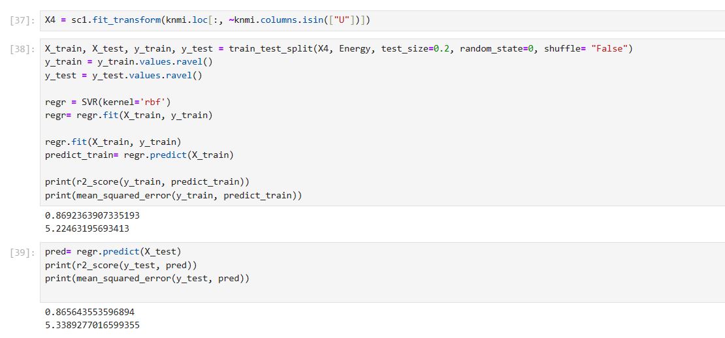
x4 - scoring

Slide 19
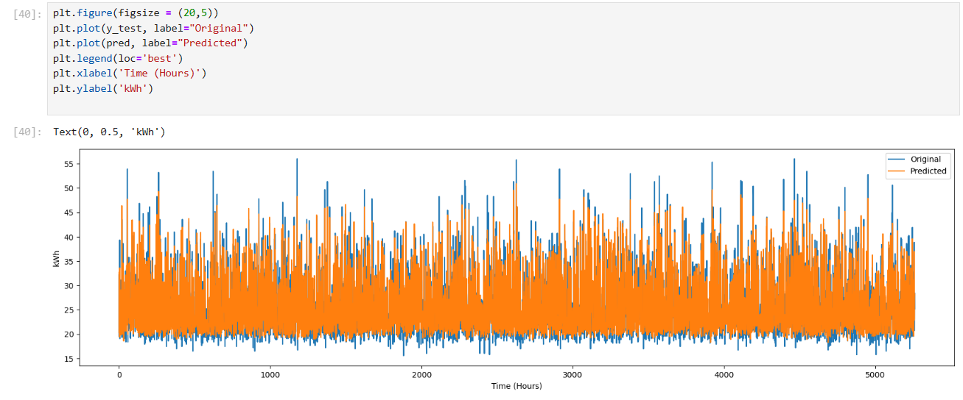
visualizing energy prediction

Slide 20
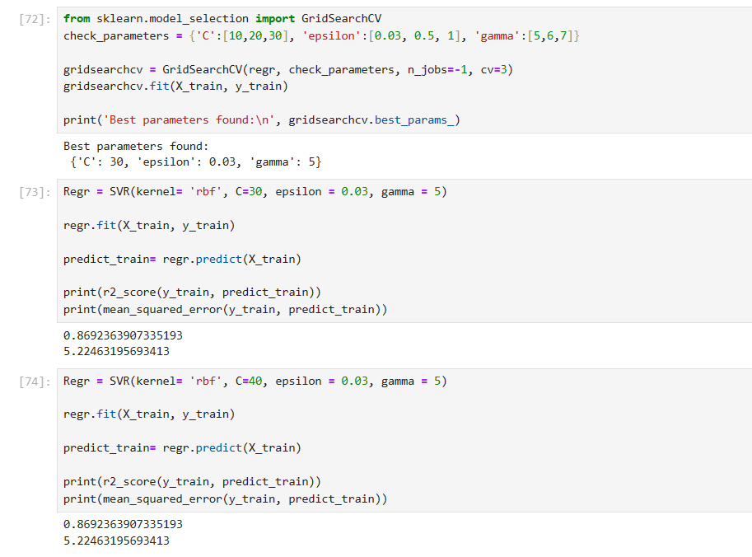
Grid search - prediction

Slide 21
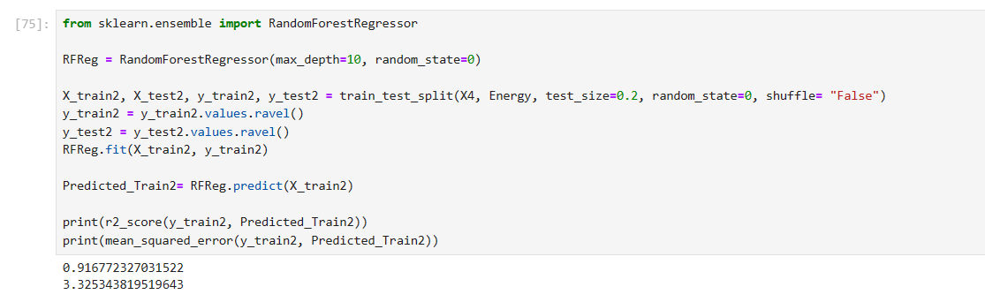
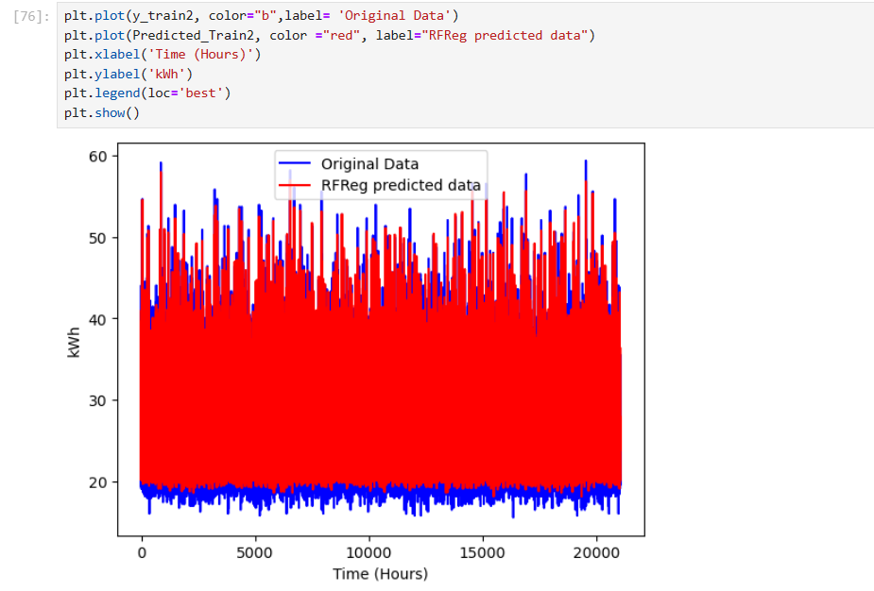
Random forest prediction

Slide 22
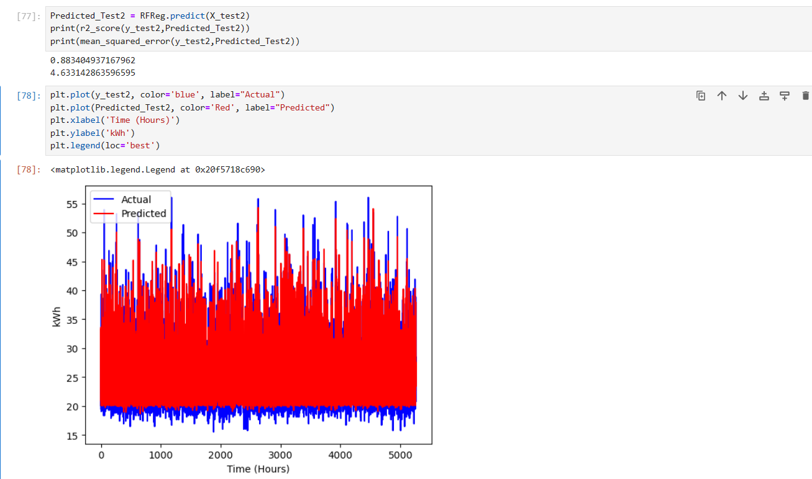

Slide 23
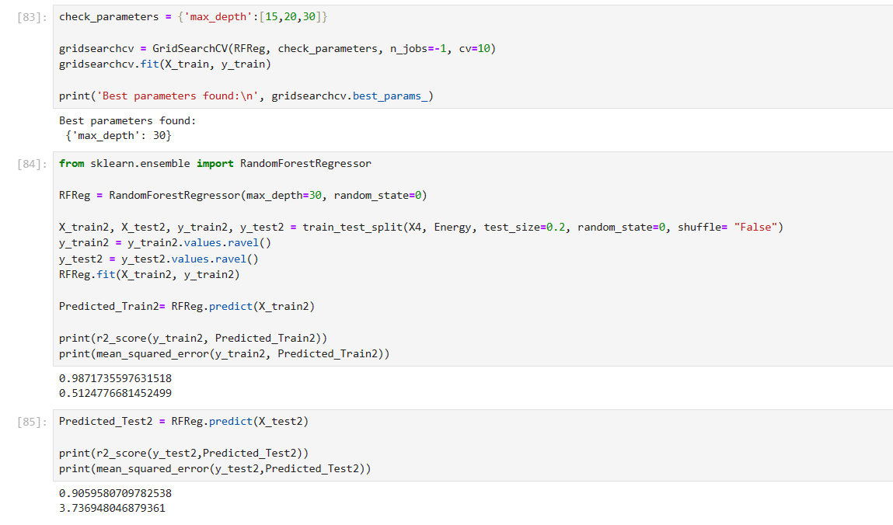
with max depth

Slide 24
Allocating budget using predictive modelling
Allocating the cost of energy consumption using predictive modeling involves several steps to ensure that the predictions are accurate and the costs are distributed fairly. Here’s an overview of how this can be done:
Data Integration:
Combining datasets related to energy consumption, weather conditions, and energy production metrics to create a comprehensive view of energy usage patterns.
Predictive Model Development:
Using machine learning algorithms, such as Linear Regression and Random Forest Regressor, to develop models that can forecast future energy demands based on historical data and other relevant factors.
Cost Prediction:
Apply the predictive models to estimate future energy consumption at different granularities (hourly, daily, monthly).
Using the predicted energy demands to calculate the expected costs based on current energy prices and tariffs.

Slide 25
Budget Allocation:
Based on the predicted costs, allocating the budget for energy consumption across different departments, processes, or time periods.
Considering by using hierarchical models to allocate costs at different levels of granularity.
Incorporating External Factors:
Including external factors such as holidays, economic changes, and weather events in the model to account for their impact on energy consumption.
Uncertainty Quantification:
Using probabilistic models to quantify the uncertainty in the predictions and include this in the cost allocation process.
Real-Time Prediction and Monitoring:
Deploying the models for real-time prediction and continuously monitor their performance.
Updating the models periodically with new data to maintain accuracy.

Slide 26
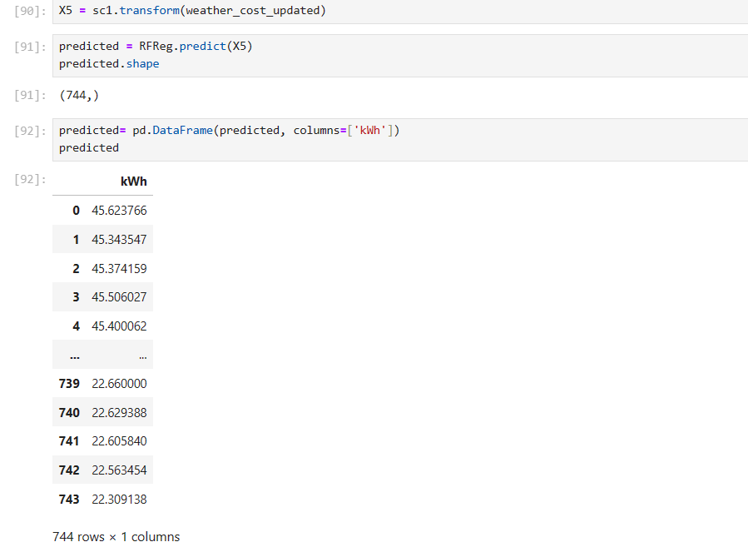
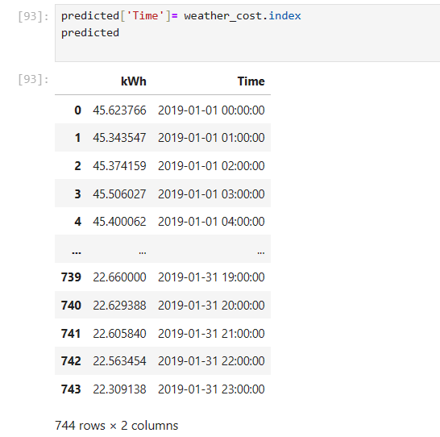
Predicting cost

Slide 27
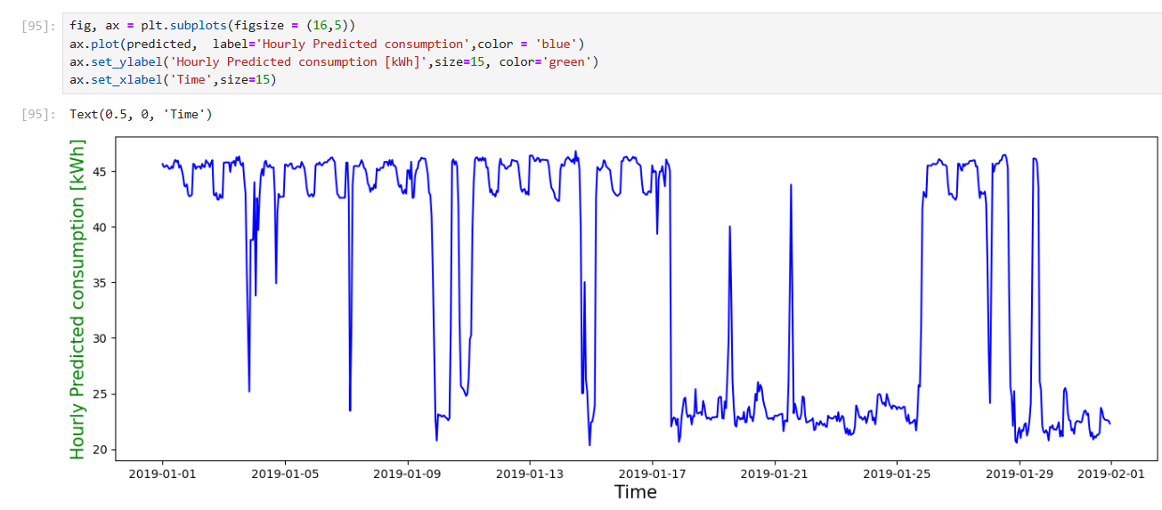
Plotting energy with time

Slide 28
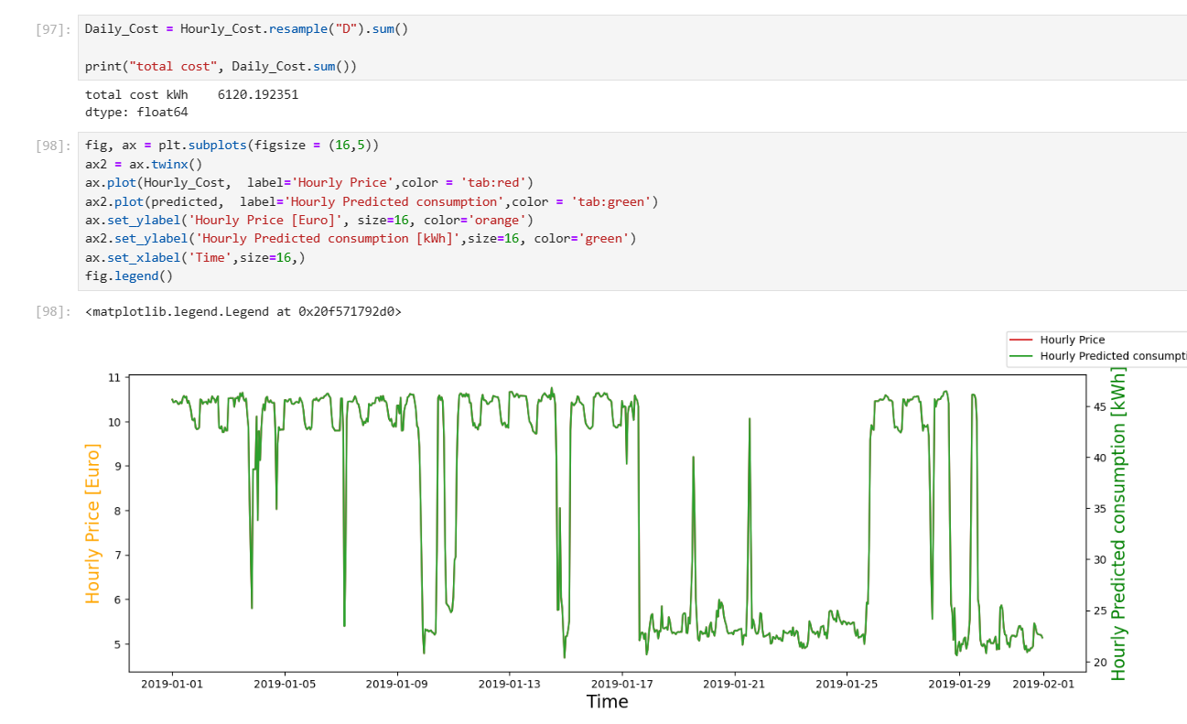
Plotting the hourly forecast consumption in kWh and calculating price for the whole month

Slide 29
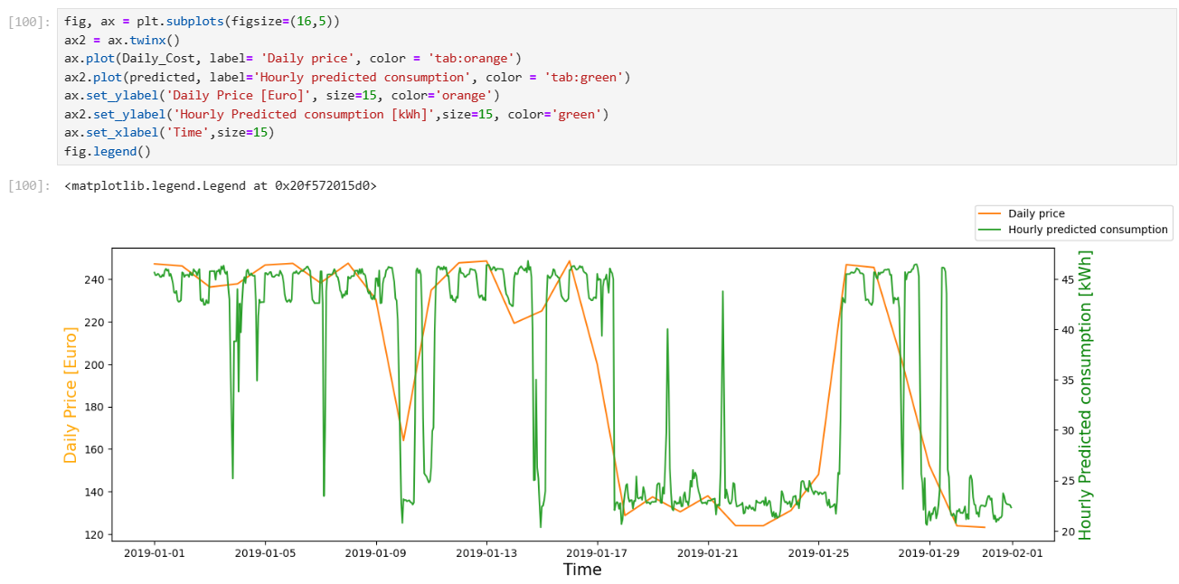
Plotting the hourly forecast consumption in kWh and calculating price for daily

Slide 30
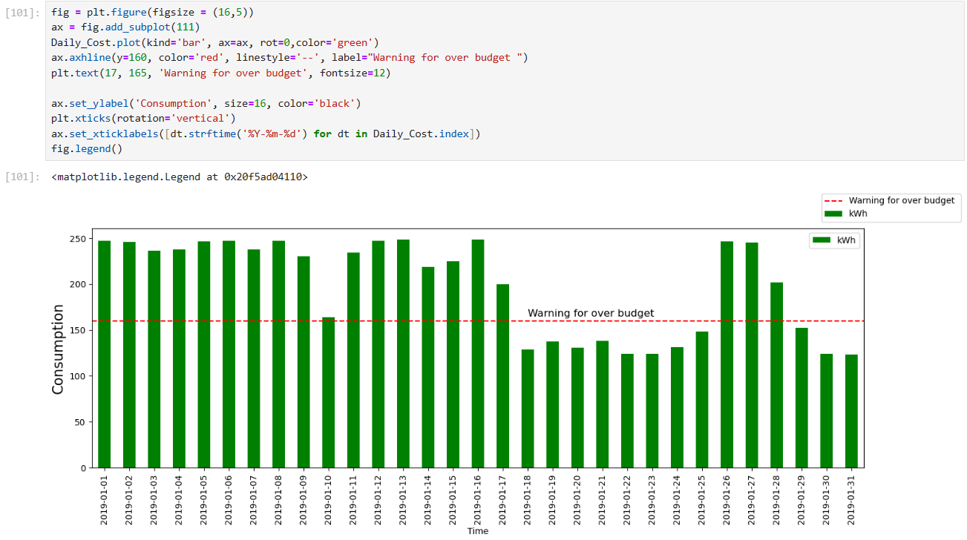
Setting a visual threshold in the forecast when the model predicts higher than a budget limit

Slide 31





WEB APPLICATION
By Streamlit
Creating a web application with Streamlit is an exciting way to bring your data projects to life.
Streamlit is an open-source app framework specifically designed for Machine Learning and Data Science projects.
It’s a great tool because it allows you to create web apps with minimal coding effort, and it integrates seamlessly with Python data ecosystems.

Slide 32
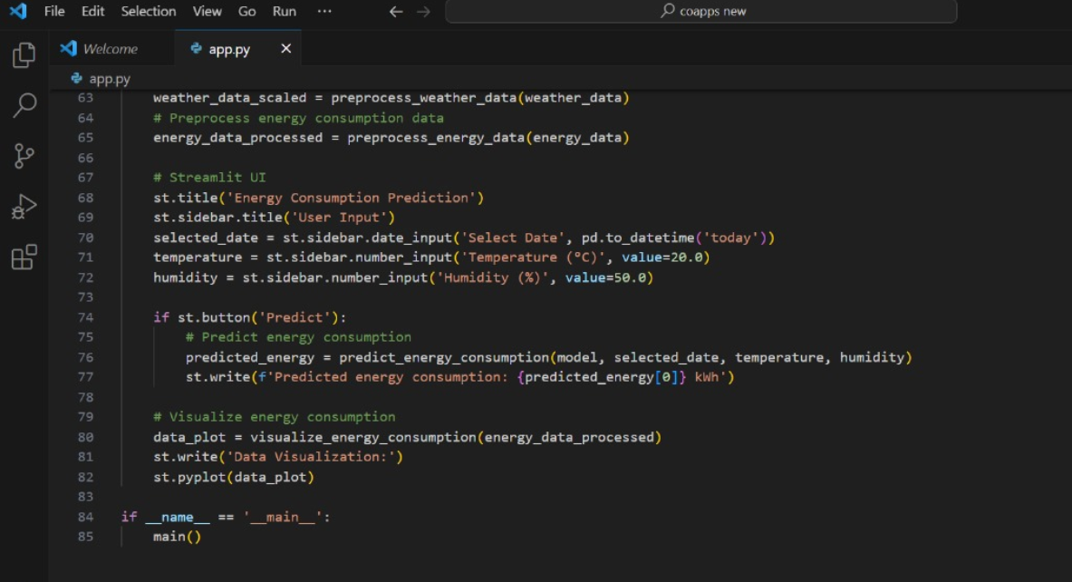
Streamlit creation

Slide 33
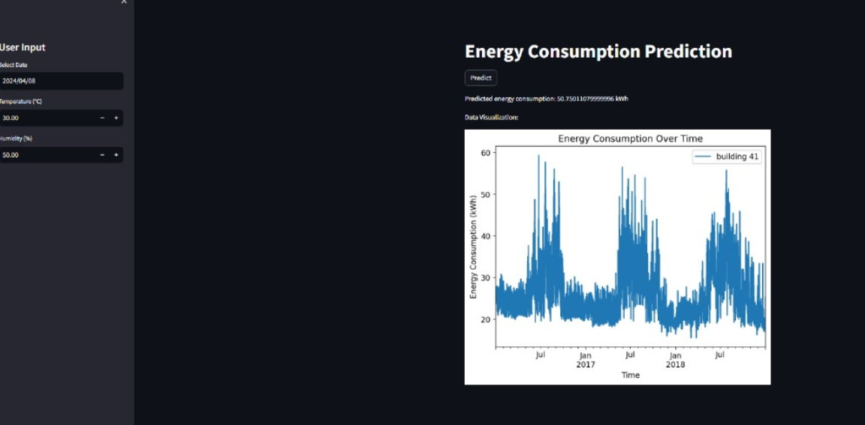
web app prediction results

Slide 34
conclusion
Here’s a concise summary for our project:
Slide 1: Key Insights from Energy Demand Prediction Analysis
Temperature Dependency: Direct correlation with energy demand.
Relative Humidity Impact: Inverse relationship affecting consumption.
Slide 2: Model Performance and Optimization
R² Value Increase: Indicates improved model accuracy.
Standard Scaler: Best performance with 86.78% variance explained in training.
Slide 3: Integrating Weather Variables
Comprehensive Approach: All weather variables considered for complex interplay analysis.
Slide 4: Hyperparameter Optimization
Grid Search Application: Enhanced model performance with fine-tuned parameters.
Slide 5: Budget Management
Exceeding Daily Budget: Current consumption surpasses 160 euros - , indicating the need for cost-effective strategies.

Slide 35







THANK YOU

